Slide 1
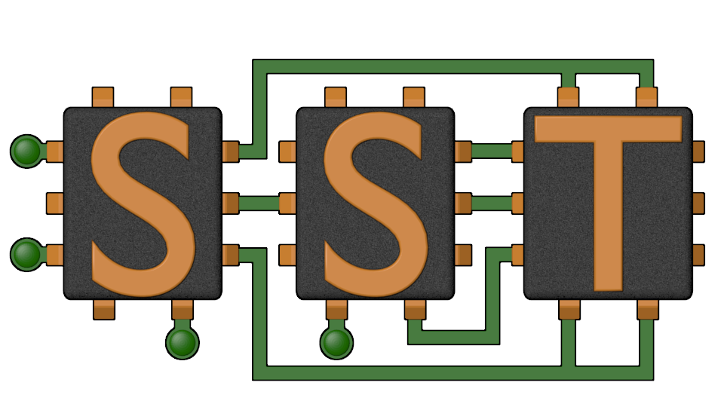
The Structural Simulation Toolkit (SST)
The SST Team
SAND2020-12392 TR

Slide 2
Agenda
1000-1005 LPS/P38 Introduction
1005-1100 SST Overview & Configuration
1100-1200 Developing with SST
1200-1215 Break
1215-1245 P38 Scatter/Gather Experiments
1245-1330 Memory hierarchy (Gwen/Scott?)
1330-1345 Break
1345-1415 Broader SST Community (LLNL, GPGPUSim, GeM5)
1415-1445 Open Discussion

Slide 3
Agenda
1000-1005 LPS/P38 Introduction
1005-1100 SST Overview & Configuration
SST Overview
Configuring & Use
SST Element Libraries
1100-1200 Developing with SST
1200-1215 Break
1215-1245 P38 Scatter/Gather Experiments
1245-1330 Memory hierarchy (Gwen/Scott?)
1330-1345 Break
1345-1415 Broader SST Community (LLNL, GPGPUSim, GeM5)
1415-1445 Open Discussion

Slide 4


Instructors
Arun Rodrigues afrodri@sandia.gov
Gwen Voskuilen grvosku@sandia.gov
Scott Hemmert kshemme@sandia.gov

Slide 5
References
Websites
http://www.sst-simulator.org/
https://github.com/sstsimulator
Configuration File Format:
http://sst-simulator.org/SSTPages/SSTUserPythonFileFormat/
Doxygen Documentation:
http://sst-simulator.org/SSTDoxygen/9.0.0_docs/html/
Developer FAQ:
http://sst-simulator.org/SSTPages/SSTTopDocDeveloperInfo/
Building SST
http://sst-simulator.org/SSTPages/SSTBuildAndInstall9dot0dot0SeriesQuickStart/
http://sst-simulator.org/SSTPages/SSTBuildAndInstall9dot0dot0SeriesDetailedBuildInstructions/

Slide 6
Simulation Intersections
Project 38 Goal: More collaborative engagement than previous ‘special projects’
SST
Modular
Simple interfaces
Designed for working w/ industry or closed projects
Has extensive cache, coherency, main memory models
Vehicle for collaboration
Have existing SST models
Could help integrate vendor models

Slide 7
Why SST? Another simulator?!
Problem: Simulation is slow
Tradeoff between accuracy and time to simulate
Many simulators are serial, with limited ability to model large, complex systems
Problem: Lack of simulator flexibility
Want to combine single-purpose simulations to model system behavior
Tightly-coupled simulators: faster but difficult to modify (e.g., change network topology…)
Adding new functionality often requires significant effort
The Structural Simulation Toolkit: A parallel, discrete-event simulation framework for scalability and flexibility

Slide 8



The Structural Simulation Toolkit
Goals
Create a standard architectural simulation framework for HPC*
Ability to evaluate future systems on DOE/DOD workloads
Use supercomputers to design supercomputers
Status
Parallel framework (SST Core)
Integrated libraries of components (Elements)
Current Release (9.0)
https://sst-simulator.org
https://github/sstsimulator
Technical Approach
Parallel Discrete Event core
With conservative optimization over MPI/Threads
Interoperability
Node and system-scale models
Multi-scale
Detailed (~cycle) and simple models that interoperate
Open
Open Core, non-viral, modular
Consortium
“Best of Breed” simulation suite
Combine Lab, Academic & Industry

Slide 9
SST Architecture
SST Core framework
The backbone of simulation
Provides utilities and interfaces for simulation components (models)
Clocks, event exchange, statistics and parameter management, parallelism support, etc.
SST Element libraries
Libraries of components that perform the actual simulation
Elements include processors, memory, network, etc.
Includes many existing simulators: DRAMSim2, Spike, HMCSim, Ramulator, etc.
Component
Component
Component
Component
Integration Services
SST Core
MPI and C++ Threads

Slide 10
SST: A Framework for Parallel Simulation
High-Level View

Slide 11
Key objects
SST::Component
CPU
SST::Component
Simulation model
SST::Link
Communication path between two components
Poll or interrupt with EventHandler
SST::Event
A discrete event
SST::Clock::Handler
Function to handle a clock tick
SST::SubComponent
Add functionality to Components
EventHandler
SST::Link
SST::Event
Load
SST::Event
Data
EventHandler
SST::Component
Cache

Slide 12

Component
Performs the actual simulation
Sends events over links to communicate with other components
Components define ports, links connect ports between components
Polled: Register a clock handler to poll the link
Interrupt: Register an event handler to be called when an event arrives
Can load SubComponents and Modules for additional functionality
Useful for parts of a component that should be swappable between simulations
Ex: scheduling algorithms, address mapping schemes, cache prefetchers
Useful for exposing interfaces to other components
Ex: network provides a subcomponent that can be loaded to handle traffic into/out of network
$$
NETWORK
CPU
CACHE
ROUTER
TRAFFIC GENERATOR
DIMM

Slide 13
Link
Connects two components
Connect a specific named “Port” on component A to a “Port” on component B
The ONLY mechanism by which components communicate
Necessary for parallel simulation
Has a minimum, non-zero latency for communication
Except self-links
Except during init/complete phases (untimed)
Transparently handles any MPI / threaded communication
Component A
Port X
Port Y
Component B
Link 1

Slide 14
Event
Unit of communication between two components
Packet format is up to the communicating components
Some standardized interfaces
Facilitates “mix and match” capability
sst-core/interfaces/
Memory (simpleMem)
Defines commands & event format for communication with caches & memory
Network (simpleNetwork)
Defines a packet format for events sent through a network component

Slide 15
SST Building Blocks
SST simulations are comprised of components connected by links
Components communicate by sending events over the links
Components define ports which are valid connection points for a link
Components can use subComponents and modules for extra functionality
SST Component
Core
SST Link
Latency: 1ns
SST Component
Cache
SST Link
Latency: 2ns
SST Component
NoC Router
SubComponent
Prefetcher
SST Link
Latency: 4ns
SST Component
Core
SST Link
Latency: 1ns
SST Component
Cache
SST Link
Latency: 2ns
SST Component
NoC Router

Slide 16
Simulating with SST

Slide 17
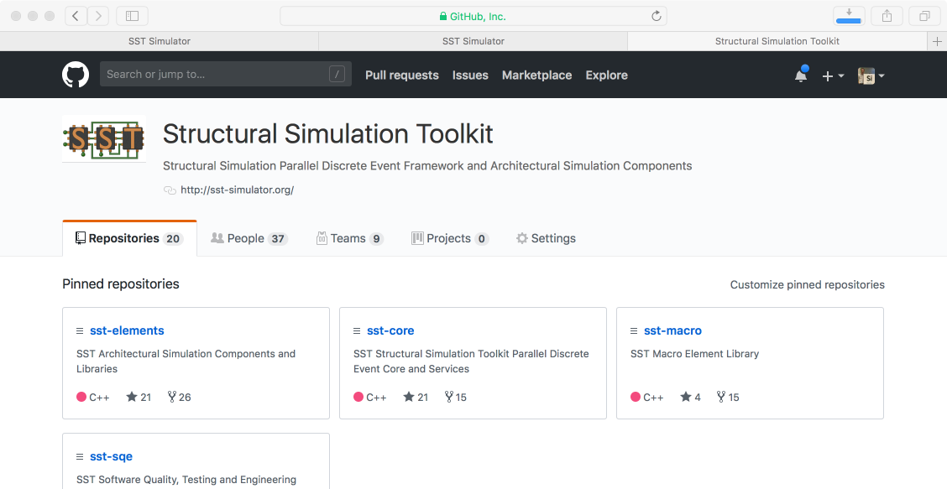
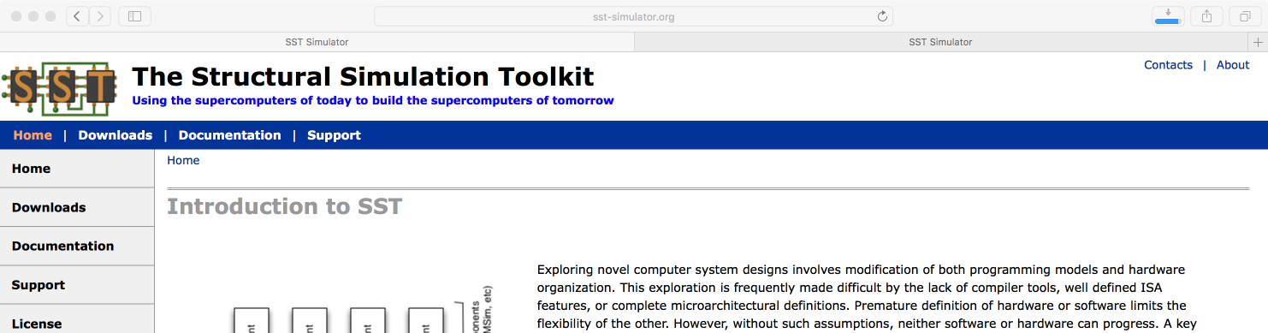
Getting and Installing SST
http://www.sst-simulator.org
Current release source download
Detailed build instructions including dependencies for Linux & Mac
Archived tutorial materials
https://github.com/sstsimulator
Source code checkout
Master branch – has passed testing
Devel branch – has passed basic testing

Slide 18

SST Code Structure
SST Core and SST Elements are compiled separately
Element libraries register with the core
External elements (not part of SST Elements) can also be registered with the core
Example at github.com/sstsimulator/sst-external-element
Core maintains a database of registered libraries
Can query database with sst-info utility
Source code for core:
sst-core/src/sst/core/
Source code for elements
sst-elements/src /sst/elements/
Most elements have a tests/ directory
Often a good starting point for example configurations
Component
Component
Component
Component
Integration Services
SST Core
MPI and C++ Threads

Slide 19
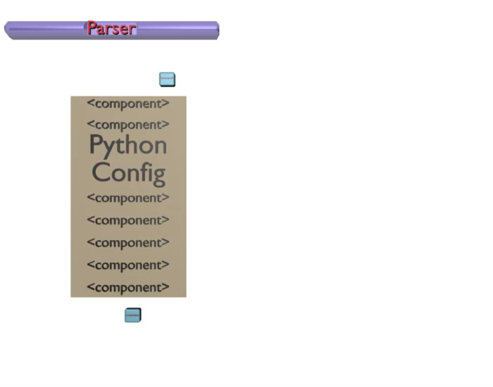
Simulation Configuration
To define simulations, users create a python configuration file which:
Defines the components and subcomponents to use
Specifies the connectivity between components
SST then:
Loads the file and converts it to a graph
Partitions the graph for parallel simulation
Instantiates the components
Runs the simulation!

Slide 20
Simulation Lifecycle
Birth
Create graph of components using Python configuration file
Partition graph and assign components to MPI ranks
Instantiate components
Connect components via links
Initialize components using their init() functions, multi-phase initialization
Setup components using their setup() functions
Life
Send events
Manage clock and event handlers
Death
Complete simulation using components’ complete() functions, multi-phase quiesce
Finalize components using their finish() functions
Output statistics
Cleanup simulation, delete components

Slide 21
Configuration File: Global SST parameters
Set any global simulation parameters
End simulation at 100ms if it hasn’t ended already
Other options
Most are also available as command line arguments to SST
sst.setProgramOption(“stopAtCycle”, “100ms”)
SST Python API
User-defined string
SST argument
Option | Definition
debug-file | File to print debug output to
heartbeat-period | If set, SST will print a heartbeat message at the specified period
timebase | Units of simulation. Default is picoseconds which enables 2/3 of a year.
partitioner | Partitioner to use for parallel execution
output-partition | File to print partition to

Slide 22
SST Partitioners
General Partitioners
linear: Partitions components by dividing Component ID space into roughly equal portions. Components with sequential IDs will be placed close together.
roundrobin: Partitions components using a simple round robin scheme based on ComponentID. Sequential IDs will be placed on different ranks.
simple: Simple partitioning scheme which attempts to partition on high latency links while balancing number of components per rank.
zoltan: zoltan parallel partitioner.
Special Partitioners
single: Allocates all components to rank 0. Automatically selected for serial jobs.
self: Used when partitioning is already specified in the configuration file (see next slide).

Slide 23
Self Partitioning
Partitioning can be specified in the python input file
Use setRank(mpi_rank, thread) on a component
User must set rank/thread pairs for all components in system, partial partitions not supported
Example:
or
Must set the partitioner to be ”self”
Can be done on command-line: --partitioner=self
Can be done in python file: sst.setProgramOption(”partitioner", ”self")
comp = sst.Component(“lib.element”)
comp.setRank(5, 4) # put this on rank 5, thread 4
comp = sst.findComponentByName(“my_comp_name”)
comp.setRank(5, 4) # put this on rank 5, thread 4

Slide 24
Configuration File: Declare components and links
Components: sst.Component(“name”, “type”)
Links: sst.Link(“name”)
core = sst.Component(“core”, “miranda.BaseCPU”)
cache = sst.Component(“L1”, “memHierarchy.Cache”)
mctrl = sst.Component(“memctrl”, “memHierarchy.MemController”)
Gen
Core
Component name
Component library.type
Cache
link0 = sst.Link(“core_to_cache”)
link1 = sst.Link(”cache_to_memory”)
MemCtrl
SST Python API
User-defined string
SST argument
Mem
Link name

Slide 25

Configuration File: Configure the components
Parameters: addParams({ “parameter” : “value”, … })
SubComponents: setSubComponent(“slotname”, “type”)
Recall: SubComponent is a swappable piece of functionality
core.addParams({ “clock” : “2.4GHz” })
Gen
Core
Cache
gen = core.setSubComponent(“generator”, “miranda.STREAMBenchGenerator”)
memory = mctrl.setSubComponent(“backend”, “memHierarchy.simpleMem”)
MemCtrl
How do I know what the options are? Or even what elements I can pick from?
Mem
SST Python API
User-defined string
SST argument

Slide 26
SSTInfo: Getting component info
sst-info: utility to query element libraries
Optionally filter for a specific library and/or component
$ sst-info miranda.BaseCPU
PROCESSED 1 .so (SST ELEMENT) FILES FOUND IN DIRECTORY(s) /home/sst/build/sst-elements/lib/…
Filtering output on Element = “miranda.BaseCPU”
================================================================================
ELEMENT 0 = miranda ()
Num Components = 1
Component 0: BaseCPU
CATEGORY: PROCESSOR COMPONENT
NUM STATISTICS = 17
…
NUM PORTS = 2
PORT 0 = cache_link (Link to Memory Controller)
…
NUM SUBCOMPONENT SLOTS = 2
SUB COMPONENT SLOT 0 = generator (What address generator to load) [SST::Miranda::RequestGenerator]
…
NUM PARAMETERS = 12
PARAMETER 0 = clock (Clock for the base CPU) [2GHz]
…
Port name
Definition
SubComponent API
Definition
Slot name
“REQUIRED” or default value
Parameter
Definition

Slide 27
Configuration File: Connecting the components
Declared links and components a couple slides ago…
Connect components: connect(endpoint1, endpoint2)
Where endpoint is: (component, port, latency)
link0 = sst.Link(“core_to_cache”)
link1 = sst.Link(“cache_to_memory”)
core = …
cache = …
mctrl = …
Gen
Core
Cache
link0.connect(
(core, “cache_link”, “100ps”),
(cache, “high_network_0”, “100ps”) )
link1.connect(
(cache, “low_network_0”, “100ps”),
(mctrl, “direct_link”, “100ps”) )
Endpoint 1
MemCtrl
Endpoint 2
Mem

Slide 28
Running a simulation
Launch (serial) simulation
Launch (threaded) simulation
Output
$ sst demo0.py
$ sst –n <#threads> demo0.py
<Simulation Specific Output>
Simulation is complete, simulated time: 6.66491 us

Slide 29
SST Elements: A Quick Tour

Slide 30

SST 9.0 Elements
Processors
Ariel – PIN-based
Juno – simple ISA processor
Miranda – pattern generator
Prospero – trace execution
GeNSA – Spiking temporal processing unit
Spike – RISC-V model by TCL
Memory Subsystem
cacheTracer – cache tracing
Cassini – cache prefetchers
CramSim – DDR, HBM
MemHierarchy – caches, directory, memory
Messier - NVM
Samba – TLB
VaultSimC – vaulted stacked memory
Network drivers
Ember – communication patterns
Firefly – communication protocols
Hermes – MPI-like driver interface
Zodiac – trace based driver
Thornhill – memory models for Ember sims
Networks/NoCs
Merlin – flexible network modeling
Kingsley – mesh NoC
Shogun – crossbar NoC
Others
sst-macro – network drivers/network
scheduler – job scheduling
simpleSimulation – “car wash” example
simpleElementExample – many examples
sst-external-element – example element

Slide 31
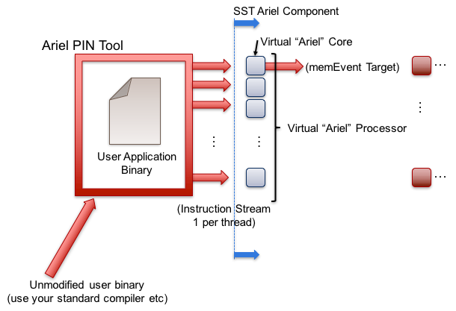

Ariel: PIN-based processor
Lightweight processor core model
Uses Intel’s PIN tools and XED decoders to analyze binaries
Runs x86, x86-64, SSE/AVX, etc. binaries
Supports fixed thread count parallelism (OpenMP, Qthreads, etc.)
Passes instructions to virtual core in SST
GPGPU-Sim Integration
Used in P38 Experiments
Processor
Memory
Network/NoC
Network driver
Other

Slide 32
Prospero: Trace-based processor
Trace-based processor model
Like Ariel, memory instruction oriented
Reads memory ops from a file and passes to the simulated memory system
“Single core” but can use multiple trace files to emulate threaded or MPI applications
Supports arbitrary length reads to account for variable vector widths
Performs “first touch” virtual to physical mapping
Comes with Prospero Trace Tool to generate traces
Or can generate your own and translate to Prospero’s format
Processor
Memory
Network/NoC
Network driver
Other

Slide 33
Miranda: Pattern-based processor
Extremely light-weight processor model
Generates memory address patterns
Supports request dependencies
Library patterns
Strided accesses (single stream)
Forward and reverse strides
Random accesses
GUPS
STREAM benchmark
In-order & out-of-order CPU
3D stencil
Sparse matrix vector multiply (SpMV)
Copy (~array copy)
Stake interface to the Spike RiscV simulator
Processor
Memory
Network/NoC
Network driver
Other

Slide 34
Vanadis processor pipeline model
Work In Progress
Initial research concept for a ISA-agnostic RISC pipeline model for SST
Provides MIPS32 ISA for simplicity and ease of development
Individual cores can run as individual SST components but can link together for single memory / address space (promotes parallelism)
Provides operating system emulation mode (does not need to boot a kernel etc)
Decoders are full SST sub-components so can be extended and swapped out
On a per-hardware thread or per-core basis
Pipeline is out-of-order and parameterized to permit hardware exploration
Execute-at-execute pipeline model
External memory (required for parallelism)
Functional units are fully extensible/swappable and individually parameterizable
Ability to add (custom) instructions into the pipeline (exploring put/get, thread mgmnt)
Still in development but initial simple runs of binaries complete successfully
Intended to be an initial “alpha” component release with SST 11.0
Processor
Memory
Network/NoC
Network driver
Other

Slide 35
Vanadis Concept designs
Flexibility and parameterization of Vanadis allows it to be used in many different design scenarios
Integration with SST allows significant degree of flexibility
Potential for different cores to have different ISAs (e.g. PIM use case)
Many small cores
Vanadis OS Handler
Vanadis Core
@ 2.5GHz
Vanadis Core
@ 2.5GHz
Vanadis OS Handler
Vanadis Core
@ 2.5GHz
Vanadis Core
@ 1.0GHz
Vanadis OS Handler
Vanadis Core
@ 2.5GHz
GPGPU
@ 1.0GHz
Big Core
Big Core
Big Core
Big Core
Vanadis Core
@ 1.0GHz
L1D
L1I
L1D
L1I
L1D
L1I
L1D
L1I
…
L1D
L1I
…
L1D
L1I
L2 (2MB)
L2 (2MB)
L2 (2MB)
L2 (128kB)
…
L2 (2MB)
L2 Shim
L2 (128kB)
NoC
NoC
NoC
Mem Ctrl
Mem Ctrl
Mem Ctrl
Vanadis Core
@ 300MHz
HBM Model (CRAMSim?)
HBM Model (CRAMSim?)
HBM Model (CRAMSim?)
Vanadis Core
@ 300MHz
Example mix-core node design
Example accelerated node design
Example processing in memory node design

Slide 36
MemHierarchy: Memory system
Collection of interoperable memory system elements
Caches
Directories
Memory controllers
Interfaces to memory models (DDR, HBM, HMC, NVM, etc.)
Scratchpads
NoC (network-on-chip) interfaces
Buses
Components are cycle-accurate/cycle-level
Capable of modeling modern cache and memory subsystems
Deep Dive This Afternoon
Used in P38 Experiments
Memory
Processor
Network/NoC
Network driver
Other

Slide 37
Merlin / Kingsley: Network simulator
Low-level networking components that can be used to simulate high-speed networks (machine level) or on-chip networks
Capabilities – Merlin
High radix router model (hr_router)
Topologies – mesh, n-dim tori, fat-tree, dragonfly
Capabilities – Kingsley
NoC-focused
Mesh topology, input only routing
Many ways to drive a network
Simple traffic generation models
Nearest neighbor, uniform, uniform w/ hotspot, normal, binomial
MemHierarchy
Lightweight network endpoint models (Ember – coming up next)
Or, make your own
Deep Dive This Afternoon
Used in P38 Experiments
Network/NoC
Processor
Memory
Network driver
Other

Slide 38
SST Overview
SST
Parallel Conservative discrete event core
Interoperability with many simulators
Multi-scale operation
Open: Non-viral license, open core
Easy Python-based configuration
Simple simulation lifecycle
Wide library of elements

Slide 39
Questions?

Slide 40
SST Element Libraries
Elements are libraries of related components
Elements must be registered with the SST core
Tells SST where to find this set of components
Includes information on parameters and statistics for each component
SST provides a set of element libraries
Processor, network, memory, etc.
Tested for interoperability within and across libraries
Many are compatible with external “components” such as Ramulator and Spike
See www.sst-simulator.org for more information
You can also register your own elements

Slide 41
Juno: Simple instruction processor
Executes a program written in simple “assembly”
32-bit wide instructions with 8 bit op codes
64-bit integer operations
ADD, SUB, DIV, MUL,
AND, OR, XOR, NOT
Jump by register value (JGT-Zero, JLZ-Zero, J-Zero)
Jump up to16 bits in either direction from current PC
Up to 253 user registers
r0 = PC
r1 = data start register
Memory
Juno
Load/Store Unit
Instruction Manager
Register File
Processor
Memory
Network/NoC
Network driver
Other

Slide 42
Ember: Overview
Ember Motif
High Level Communication Pattern and Logic
Generates communication events
Ember Engine
User
Binary
Event to Message Call, Motif Management
Handles the tracking of the motif
Hermes API
Message Passing Semantics
Collectives, Matching, etc.
Firefly
Packetization and Byte Movement Engine
Generates packets and coordinates with network
Merlin Network
Flit Level Movement, Routing, Delivery
Moves flits across network, timing, etc.
Network driver
Processor
Memory
Network/NoC
Other

Slide 43
Ember: Network Traffic Generator
Light-weight endpoint for modeling network traffic
Enables large-scale simulation of networks where detailed modeling of endpoints would be expensive
Packages patterns as motifs
Can encode a high level of complexity in the patterns
Generic method for users to extend SST with additional communication patterns
Intended to be a driver for the Hermes, Firefly, and Merlin communication modeling stack
Uses Hermes message API to create communications
Abstracted from low-level, allowing modular reuse of additional hardware models
Network driver
Processor
Memory
Network/NoC
Other

Slide 44
Ember: Motifs
Motifs are lightweight patterns of communication
Tend to have very small state
Extracted from parent applications
Models as an MPI program (serial flow of control)
Many motifs acting in the simulation create the parallel behavior
Example motifs
Halo exchanges (1, 2, and 3D)
MPI collections – reductions, all-reduce, gather, barrier
Communication sweeping (Sweep3D, LU, etc.)
Network driver
Processor
Memory
Network/NoC
Other

Slide 45
Ember: Motifs (continued)
The EmberEngine creates and manages the motif
Creates an event queue which the motif adds events to when probed
The Engine executes the queued events in order, converting them to message semantic calls as needed
When the queue is empty, the motif is probed again for events
Events correspond to a specific action
E.g., send, recv, allreduce, compute-for-a-period, wait, etc.
Network driver
Processor
Memory
Network/NoC
Other

Slide 46
Firefly: Network traffic
Purpose: Create network traffic, based on application communication patterns, at large scale
Enables testing the impact of network topologies and technologies on application communication at very large scale
Scales to 1 million nodes
Supports multiple “cores” per Node
Interaction between cores limited to message passing
Supports space sharing of the network
Multiple “apps” running simultaneously
Network driver
Processor
Memory
Network/NoC
Other

Slide 47
Firefly: Simulating large networks
A network node consists of
Driver (the “application”)
NIC
Router
Nodes are connected together via routers to form a network
Fat tree, torus, etc.
Firefly is the interface between the driver and the router
Message passing library → Firefly Hades
NIC → Firefly NIC
Ember
(driver)
Firefly Hades
Firefly NIC
Merlin Router
Network driver
Processor
Memory
Network/NoC
Other

Slide 48
Scheduler: Job scheduling
Models HPC system-wide job scheduling
Three components
Sched: schedules and allocates resources for a stream of jobs
Node: runs scheduled jobs on their allocated resources
FaultInjection: injects failures onto the resources
The scheduler can be a stand-alone element library
The schedComponent and nodeComponent must be used together
The faultInjectionComponent is optional
Can be used with Ember/Firefly/Merlin stack
Examine topology aware scheduling and allocation
Other
Processor
Memory
Network/NoC
Network driver

Slide 49

So many simulators, so little interoperability
Already a rich selection of open-source simulators
But not a solid ecosystem for modeling systems
Tightly-entangled components make modifications complex
E.g., assumptions about caching or address mapping pervasive
Most simulator integrations are ad-hoc, not lasting
Significant performance problems with tying many simulators together
Wants:
Enable “mix-and-match” of existing models to create custom systems
Encourage disentangled models with clean interfaces for swapping functionality
Bricks not buildings
Low effort, high performance parallel simulation
Continuous path from low-fidelity/fast modeling to high-fidelity/slow models

Slide 50
SubComponents and Modules
Component: Core
Add additional functionality to a Component
SubComponent (SC): shares common base class with Component
Module (M): self-contained functionality (no access to Component class functionality
Provide modularity
Generic interface which can be used by multiple SC/M
Components load SC/M at runtime
Tightly-coupled with a component
Components call SC/M as a C++ class instance
Do not need to communicate via links
SC/M cannot exist by themselves
Example
Miranda core loads a pattern generator subcomponent to generate a sequence of memory ops
SubComponent: Stream Gen
or
Component: Core
SubComponent: SpMV Gen
or
Component: Core
SubComponent: Random Gen
Notes:
Finish: define subcomponent & module!

Slide 51
Component/Link Interface
Components use these calls to manage links and events
SST::Component::configureLink()
Registers a link and (optionally) a handler
SST::Link::recv()
Pull an event from a link
SST::Link::send()
Push an event down a link
SST::Component::registerClock()
Register a clock frequency and a handler to be called on each clock tick

Slide 52
Simulating with SST
We’ll walk through how to configure a simulation and then run it
Available at: https://github.com/sstsimulator/sst-tutorials/tree/master/pact2019/demos
( github → sstsimulator → sst-tutorials → pact2019 )
Element libraries in our example simulation
Miranda - Simple core model that runs generated instruction streams
Generators produce memory access patterns (SubComponents)
memHierarchy – Various cache/memory system related subcomponents and modules
Cache (Component) with coherence protocol SubComponent
Memory Controller (Component) that loads a memory timing model (SubComponent)
Gen
Core
L1 Cache
MemCtrl
Mem
2.4GHz, issue 2 accesses/cycle
Stream triad generator
Three 1K element arrays A,B,C
Compute C[i] = A[i] + 2*B[i]
→ 2K reads & 1K writes
2KB, 4-way set associative
2.4GHz, 2 cycle access
64B cache lines
LRU replacement MESI coherence protocol
50ns constant access latency
1GB capacity

Slide 53
SST in Parallel
MPI Rank 0
Comp0
Comp2
Comp4
Comp6
SST was designed from the ground up to enable scalable, parallel simulations
Components distributed among MPI ranks
And/or threads
Links allow parallelism
Hence, components should communicate via links only
Transparently handle any MPI/thread communication
Specified link-latency determines synchronization rate
Comp1
Comp3
Comp5
Comp7
Same configuration file
MPI Rank 0
MPI Rank 1
MPI Rank 2
MPI Rank 3
Comp0
Comp2
Comp4
Comp6
Comp1
Comp3
Comp5
Comp7
Notes:
Links handle serialization

Slide 54
Enabling statistics
Most Components and SubComponents define statistics
Enable statistics in the configuration file
enableAllStatisticsForAllComponents()
enableAllStatisticsForComponentType(type)
enableAllStatisticsForComponentName(name)
setStatisticLoadLevel(level)
Configure output
setStatisticOutput(“sst.output_type”)
setStatisticOutputOptions({“option” : “value”, })
$ sst-info memHierarchy.Cache
…
NUM STATISTICS = 51
STATISTIC 0 = CacheHits [Total number of cache hits] (count) Enable Level = 1
STATISTIC 1 = latency_GetS_hit [Latency for read hits] (cycles) Enable level = 1
enableStatisticForComponentName(name, stat)
enableStatisticForComponentType(type, stat)

Slide 55
Running with statistics enabled
Let’s enable statistics for all components
Caches have A LOT of statistics so send the output to a CSV file
Other options: sst.statoutputX where X=
console
json
txt
hdf5
sst.setStatisticOutput(“sst.statoutputcsv”)
sst.setStatisticOutputOptions({ “filepath” : “stats.csv” })
sst.setStatisticLoadLevel(5)
sst.enableAllStatisticsForAllComponents()

Slide 56
Running SST
Usage: sst [options] configFile.py
Common options:
-v | --verbose | Print information about core runtime
--debug-file <filename> | Send debugging output to specified file (default: sst_output)
--partitioner <zoltan | self | simple | rrobin | linear | lib.partitioner.name> | Specify the partitioning mechanism for parallel runs
-n | --num_threads <num> | Specify number of threads per rank
--model-options “<args>” | Command line arguments to send to the Python configuration file
--output-partition <filename> | Write partitioning information to <filename>
--output-dot <filename> --output-xml <filename> --output-json <filename> | Output the configuration graph in various formats to <filename>
Notes:
Is this still up to date?

Slide 57
SST in a Nutshell
Parallel Discrete-Event Simulator Framework
Flexible framework enables multitude of custom “simulators”
Demonstrated scaling to over 512 processors
Comes with many built-in simulation models
Processors, memory, network
“Mix & Match”
Open API
Easily extensible with new models
Modular framework
Open-source core
Time-scale independent core
Handles Micro-, Meso-, Macro-scale simulations
C++, Python
Network
CPU
CPU
Memory

Slide 58
SST in parallel
SST was designed from the ground up to enable scalable, parallel simulations
Components distributed among MPI ranks/threads
Link latency controls synchronization rate
MPI Rank 0
Comp0
Comp2
Comp4
Comp6
Comp1
Comp3
Comp5
Comp7
# Two ranks
$ mpirun –np 2 sst demo1.py
# Two threads
$ sst –n 2 demo1.py
# Two ranks with two threads each
# This will give a warning since we only
# have 3 components across 4 ranks/threads
$ mpirun –np 2 sst –n 2 demo1.py
Same configuration file
MPI Rank 0
MPI Rank 1
MPI Rank 2
MPI Rank 3
Comp0
Comp2
Comp4
Comp6
Comp1
Comp3
Comp5
Comp7
Notes:
Links handle serialization

Slide 59
Prospero: The Tradeoff
Pros
Faster than Ariel*
Provided you can get a trace
Cons
Traces can be very large
Requires good I/O system to store and read the trace
Traces are less flexible than actual execution
Capture a single execution stream using a single application input
Processor
Memory
Network/NoC
Network driver
Other

Slide 60
Miranda: The tradeoffs
Pros
Very lightweight – no binary, no trace
Good for applications whose address patterns are predictable
e.g., not much pointer-chasing
Models instruction dependences
Cons
Need a generator for the memory pattern of interest
Requires a good understanding of the pattern
Processor
Memory
Network/NoC
Network driver
Other

Slide 61
MemHierarchy: Cache modeling
Highly configurable
Arbitrary hierarchy depth, flexible topologies
Cache inclusivity, coherence, private/shared, etc. configurable
Single- and multi-socket configurations
Prefetch via Cassini element library
Data movement
Components support direct, bus, and on-chip network (NoC) communication
Event types: read/write, atomics, LLSC, noncacheable, custom memory, etc.
Memory
Processor
Network/NoC
Network driver
Other

Slide 62
MemHierarchy: Memory modeling
Interface to memory is the MemController
MemControllers implement backends
Timing model for memory controller with a link to memory
Timing model for memory controller and memory
Interface to another component(s) that does the memory controller/memory timing
In this case just translates request formats
Wrapper for an external/non-native-SST component
Ramulator, DRAMSim2, etc.
Support custom memory instructions
Including ability to do cache shootdowns for coherence maintenance
Memory
Processor
Network/NoC
Network driver
Other

Slide 63
MemHierarchy: Memory modeling
Memory controller
Manages data values if needed (backing store)
Facilitates custom memory commands
Including cache shootdowns for coherence maintenance
Passes events to memory backend subcomponent
Backend: the “real” memory controller and/or memory
Implementations
Memory controller and model itself
Memory controller with interface to a memory component
Interface to another memory controller/memory component
Wrapper to an external simulator
Memory Controller
Backing store
Custom command handler
Backend
To memory component (optional)
Memory
Processor
Network/NoC
Network driver
Other

Slide 64
MemHierarchy: SST 9.0 backends
Memory (external)
CramSim (DDR, HBM)
DRAMSim2 (DDR)
PagedMulti – 2-level memory variant
FlashDIMMSim (FLASH)
HMCSim/GoblinHMC (HMC)
HBMDRAMSim2 (HBM)
HBMPagedMulti – 2-level memory variant
Messier (NVRAM)
Ramulator (DDR, HBM, HMC)
SimpleDRAM (DDR)
SimpleMem (constant latency)
TimingDRAM (DDR)
VaultSimC (HMC-like)
Plus a few that can be used with other backends to reorder requests, add latency, etc.
Memory
Processor
Network/NoC
Network driver
Other

Slide 65
Merlin: Organization
Router
NIC
PC
XBAR
PC
TrafficGen
TestNIC
User Logic
LC
PC
PC
PC
PC
LC = LinkControl
PC
PC
Topology
PC = PortControl
Network/NoC
Processor
Memory
Network driver
Other

Slide 66
Kingsley: Mesh simulator
Network-on-chip model; mesh configuration
Similar to Merlin but:
No input queuing at routers
Mesh topology only
Not all ports need to be populated
Possible to instantiate multiple unconnected networks
Multiple physical networks for coherence (e.g., request/response/ack/forward)
Kingsley NoC + Merlin/Kingsley system network
Core
Core
Core
Core
Core
Core
Core
Core
Core
Core
Core
Core
Core
Core
Core
Core
NIC
Interconnect
Network/NoC
Processor
Memory
Network driver
Other

